Slide 1
Operating Systems – Spring 08
Instructor: Dave Hollinger ( Dave )
Web Site:
www.cs.rpi.edu/~hollingd/opsys

Slide 2
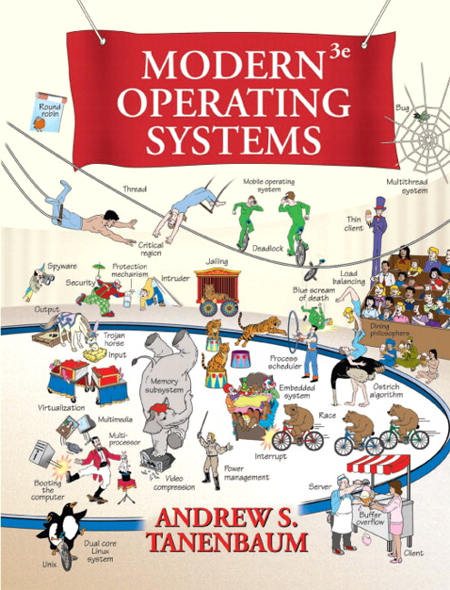
TextBook
Required!
Great book – easy to read.
We will also rely on information from other sources (on the www).

Slide 3
Grades
55%: Projects/Homework
  some large programming projects
  possibly some research projects
45%: Tests (three – each worth 15%)
  dates are on the syllabus.
No Final Exam
  the last test will be during the last class meeting.

Slide 4
Lectures
Ask questions!
  If you are lost, force Dave to back up.
  There are no stupid questions.
    well, there are stupid questions, but don't let that stop you. The TAs do the grading, so even if Dave has the impression that you are clueless it won't affect your grade!
Read before the lecture
  you will get a lot more out of the lecture.
  you may be able to help Dave if he gets stuck!

Slide 5
Projects/Homework
Some large programming projects.
  written in C (sometimes C++ is OK).
  Unix Systems Programming.
Some small programming projects.
  use whatever language you want...
Possibly some research projects:
  design data structures/algorithms
  look at open source OS code and write a report.

Slide 6
Unix Programming
Everyone must have a CS account.
ssh to freebsd.remote.cs.rpi.edu:
  monica,ashley & mary-kate.cs.rpi.edu
Grading will be done on BSD!
Develop code anywhere you want, but make sure you test on FreeBSD!

Slide 7
CS Accounts
Remote access to CS department workstations.
New email address: username@cs.rpi.edu
CS Lab documentation: www.cs.rpi.edu/lab
  Instructions on how to access machines, etc.
  web based email management (spam filtering, forwarding, etc.)
  Account restrictions, etc.

Slide 8
CS Workstations
You don't have a machine all to yourself!
  learn about the ps command.
  make sure you know how to kill a process gone bad.
  pay attention to how much disk space you use!
    df and du can be helpful.
  learn to annoy people!:
for user in `who -q | grep -v \#`; do echo "Hello" | write $user; done

Slide 9
Tentative Schedule
The Syllabus includes tentative reading schedule, this will certainly change...
  The test dates will not change!
We will follow the book fairly closely, although we will also look at other sources of information.
  The book is great for “the big picture”, but we need to look elsewhere for details...

Slide 10
Academic Integrity
Any duplicate or near duplicate homework submissions will result in a minimum of a 2 letter grade drop for the final course grade for all students involved and may result in a failure for the entire course.
For programming projects, you may discuss homework with other students (this includes WebCT discussion boards) but sharing of code in any form is not acceptable.
Looking at another student's code or showing your code to another student is not permitted.
You cannot look at or use code written by a student in Opsys in a previous semester (Dave checks for this!).
Code you submit must be written by you (it's ok to start with sample code provided by Dave).

Slide 11
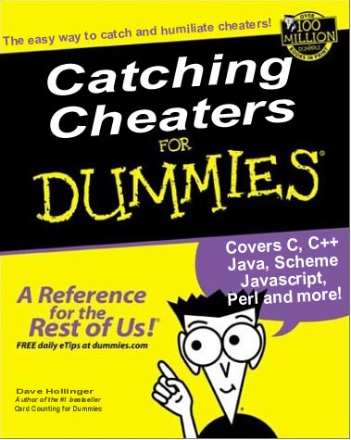
Dave is a world renowned cheater catcher and author!

Slide 12
Programming Project Requirements
Every file must include a comment at the top of the file including your name.
There must be a file named README that includes your name, a one-line description of each file submitted, instructions for building, etc.
You must comment your code – if we can't easily follow your code you lose points.

Slide 13
Course Topics
History
Systems Programming
Deadlock
Memory
I/O
File Systems
Security
Networking
Multimedia ?
Multiple Processors
Case Studies
  Linux, FreeBSD
  Windows

